Slide 1
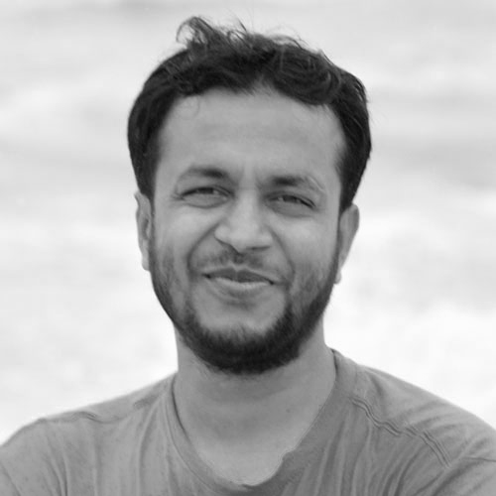
JavaScript
Shohel Rana
Lead frontend engineer
Dhaka, Bangladesh
Email: iamshohelrana@gmail.com
Lesson 3

Slide 2

Thank you today

